Slide 1
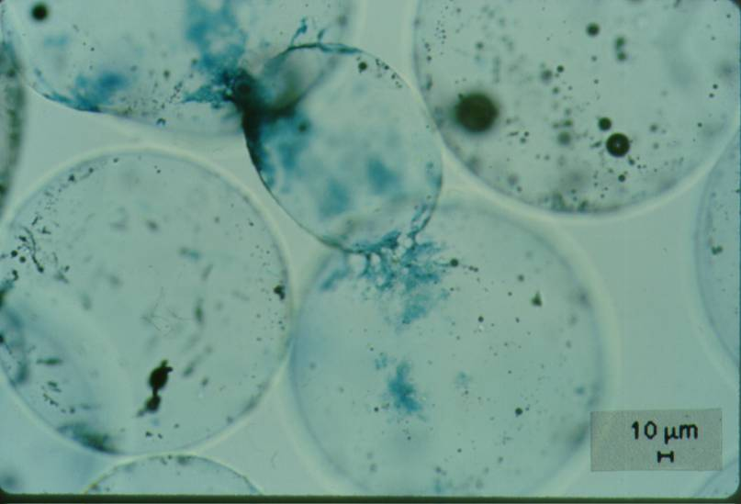
Contact Points

Slide 2
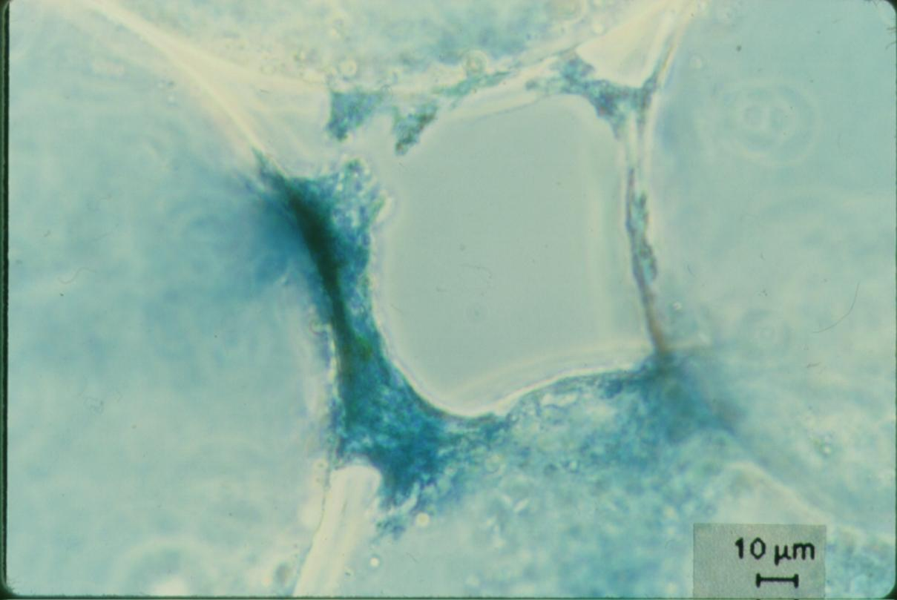
Polymer Accumulation in a Pore

Slide 3
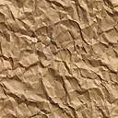
Particle Removal Mechanisms in Filters
Transport to a surface
collector
Molecular diffusion
Inertia
Gravity
Interception
Attachment
Straining
Coagulant nanoparticles
Gravity

Slide 4
Filtration Performance: Dimensional Analysis
Performance = f(forces, geometry)
What is the parameter we are interested in measuring? _________________
How could we make performance dimensionless? ____________
What are the important forces?
Effluent concentration
C/C₀ or pC*
transport
attachment
Inertia
Thermal
Sticky? (α – attachment efficiency)
Viscous
Gravitational
Need to create dimensionless force ratios!

Slide 5
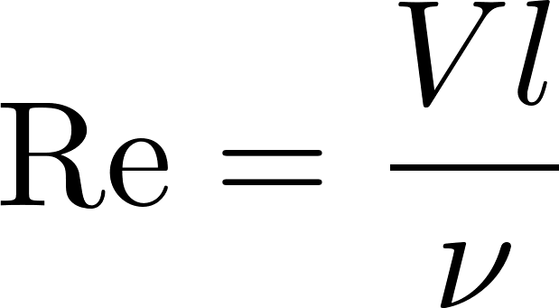
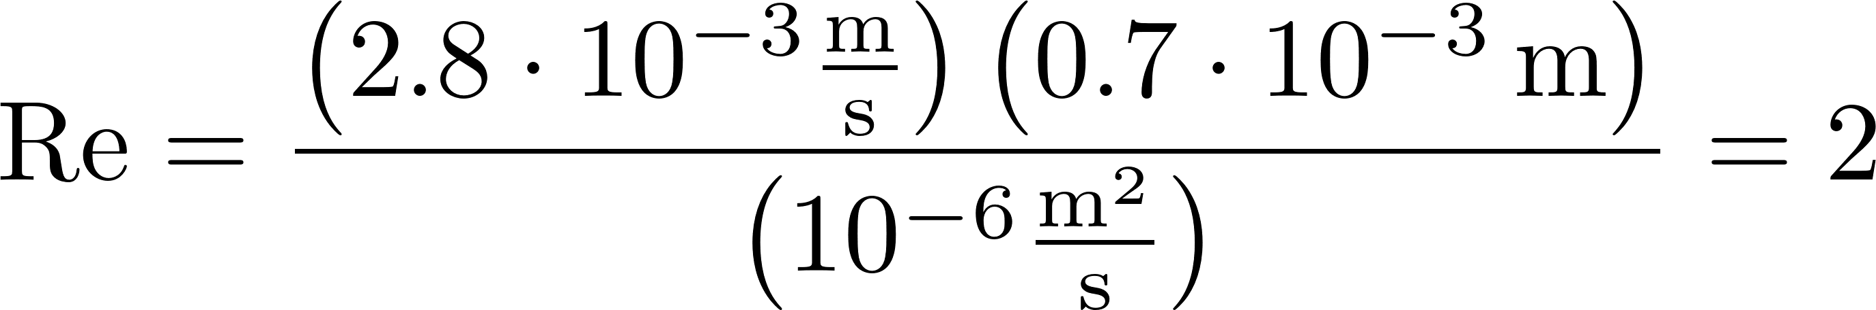
What is the Reynolds number for filtration flow?
What are the possible length scales?
Void size (collector size) 0.7 mm in RSF
Particle size
Velocities
V_{Fi} varies between 0.03 mm/s (SSF) and 2.8 mm/s (RSF)
Take the largest length scale and highest velocity to find max Re
Flow through SSF, RSF, and StaRS is laminar during filtration

Slide 6

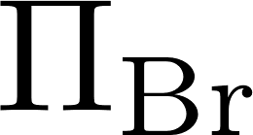
Choose viscosity!
In Fluid Mechanics inertia is a significant “force” for most problems
In porous media filtration viscosity is more important that inertia.
We will use viscosity as the repeating parameter and get a different set of dimensionless force ratios
Inertia
Gravitational
Thermal
Viscous
Viscous

Slide 7
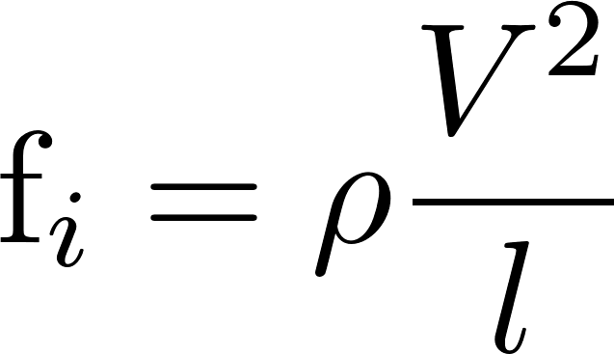
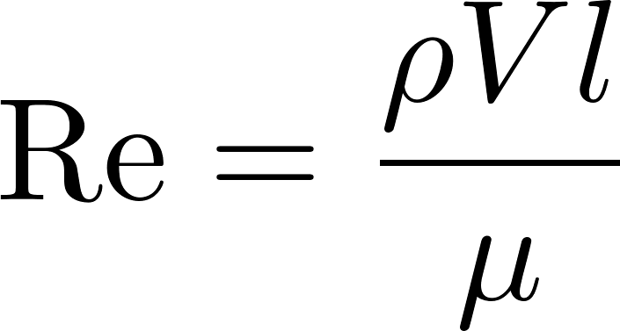
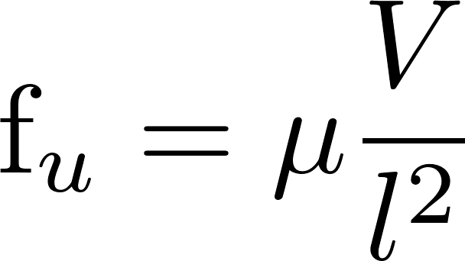
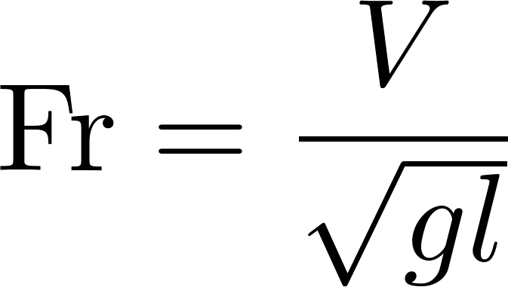
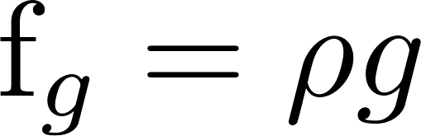
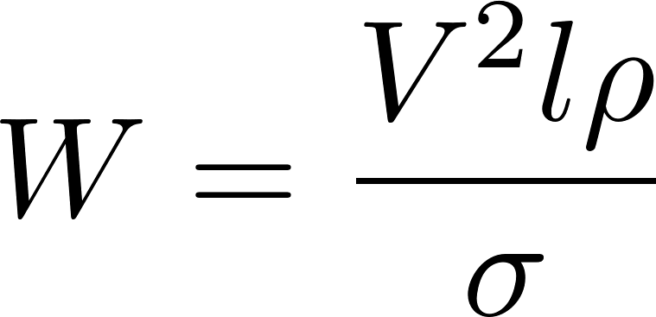
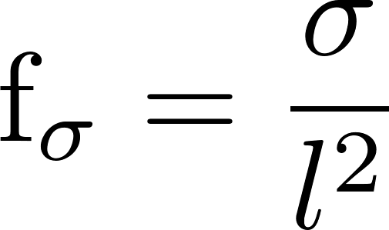
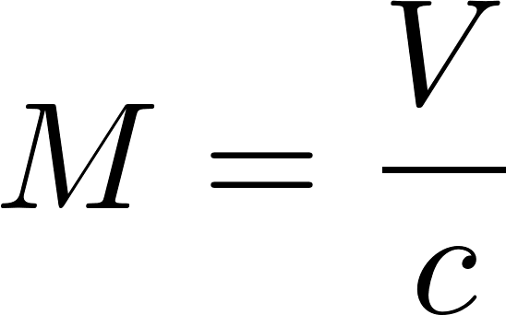
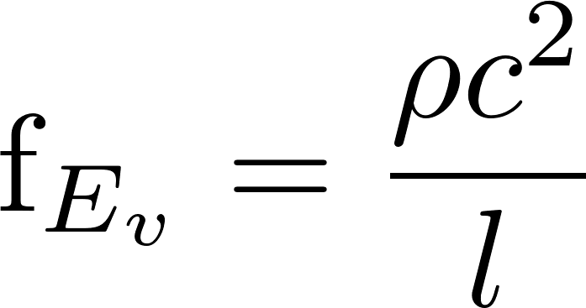
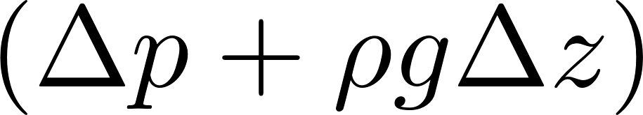
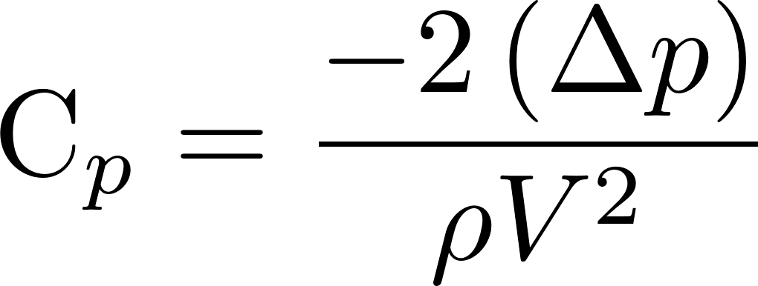
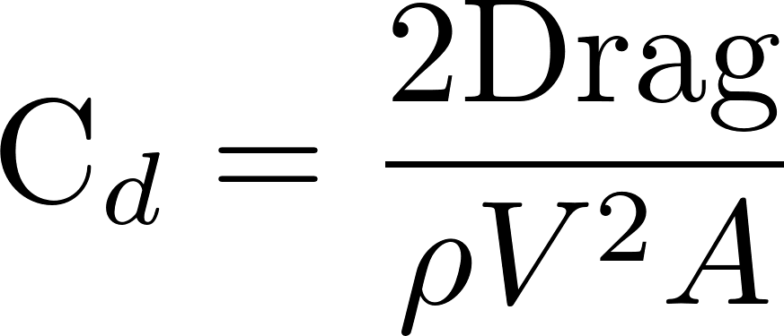
Dimensionless Force Ratios
Reynolds Number
Froude Number
Weber Number
Mach Number
Pressure/Drag Coefficients
(dependent parameters that we measure experimentally)

Slide 8


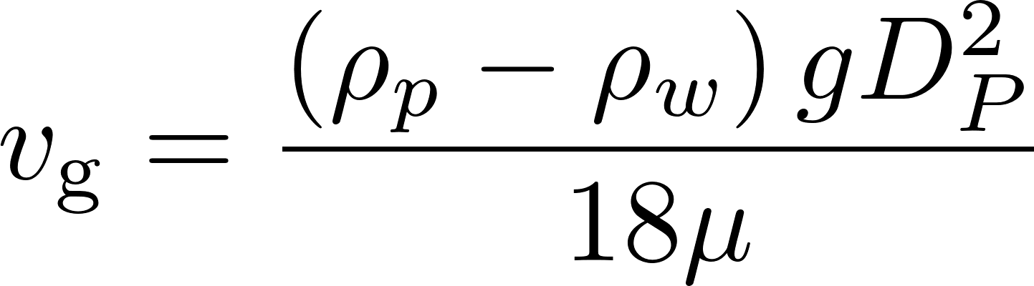
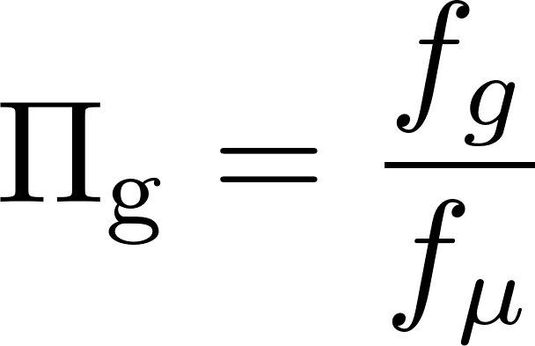
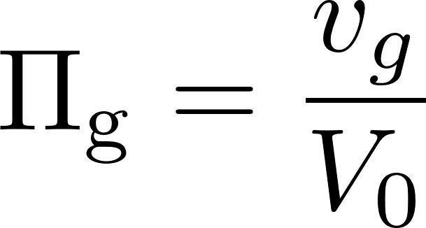
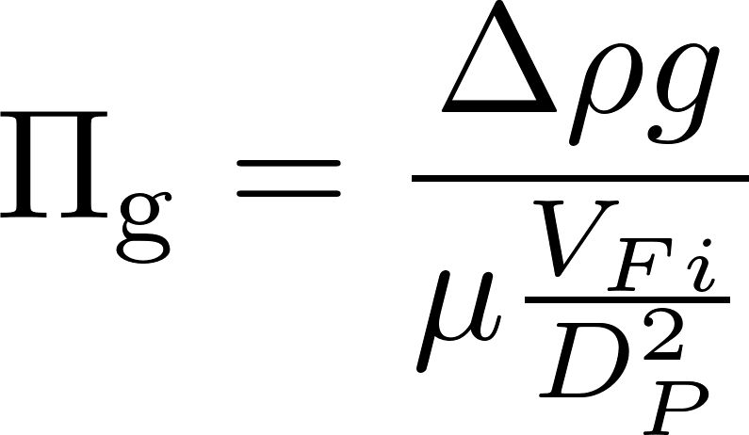
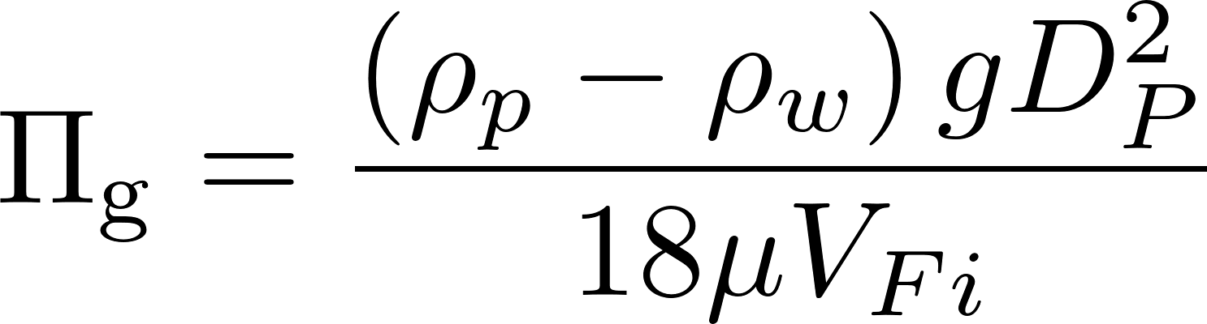
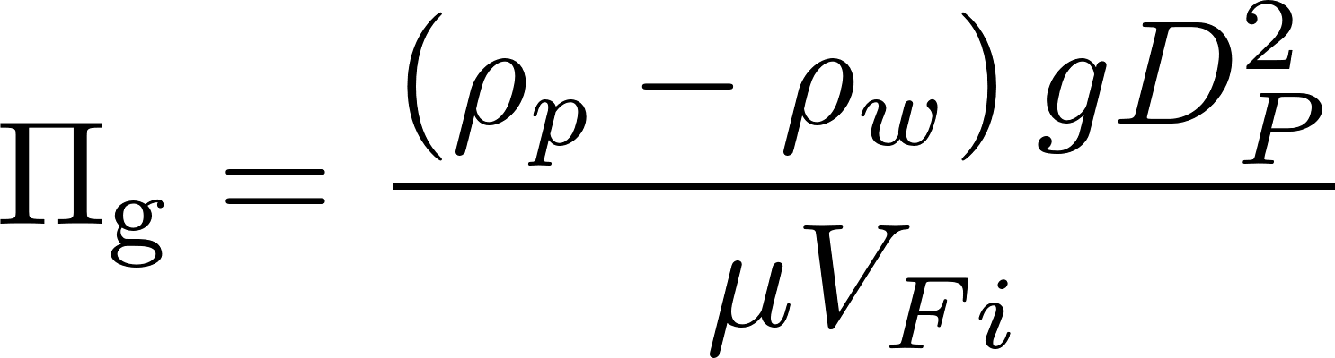
Gravity
velocities
forces
v
pore
Gravity only helps when the streamline has a _________ component.
horizontal
Use this definition

Slide 9
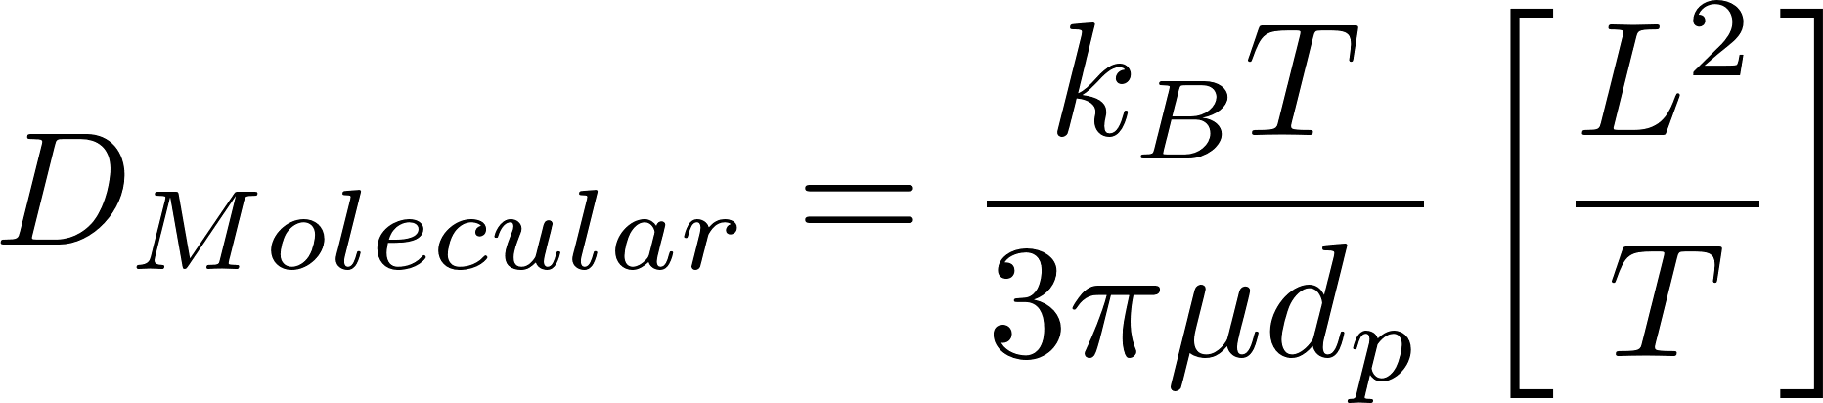
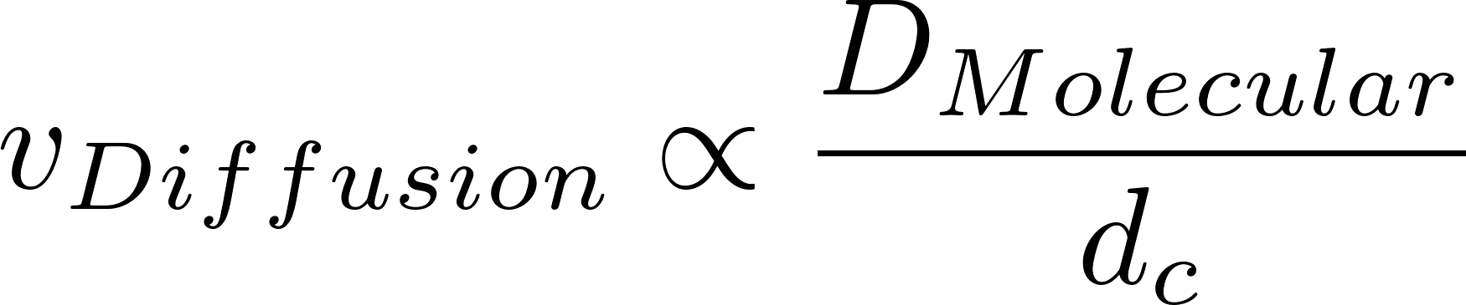
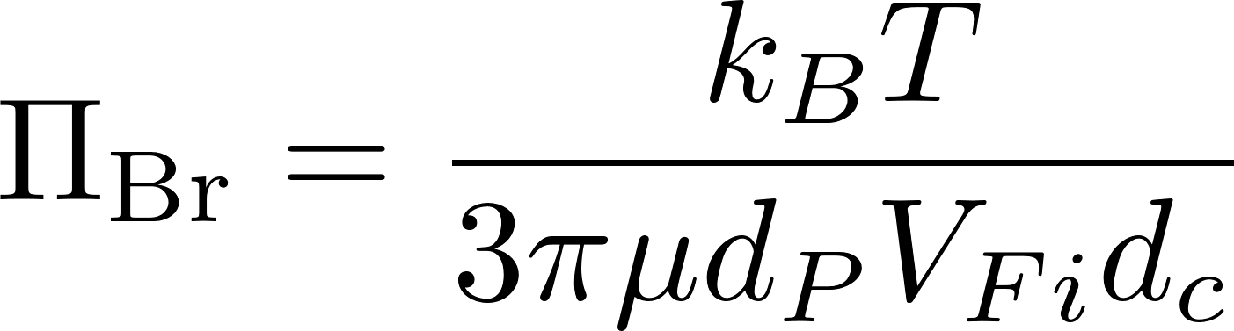
Diffusion (Brownian Motion)
v
pore
Diffusion velocity is high when the particle diameter is ________.
k_{B}=1.38 x 10⁻²³ J/°K
T = absolute temperature
small
d_{c} is diameter of the collector

Slide 10
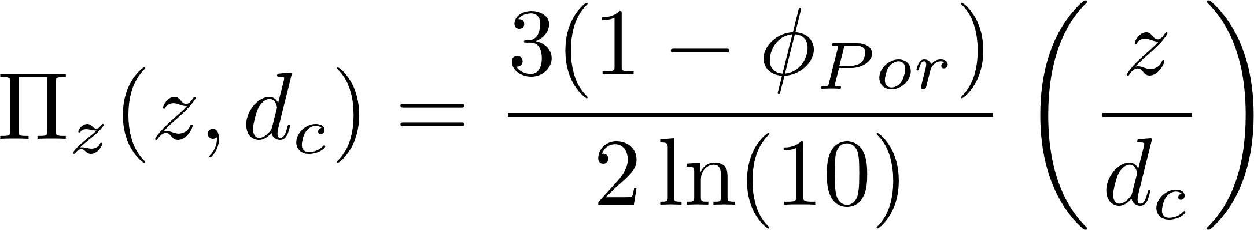
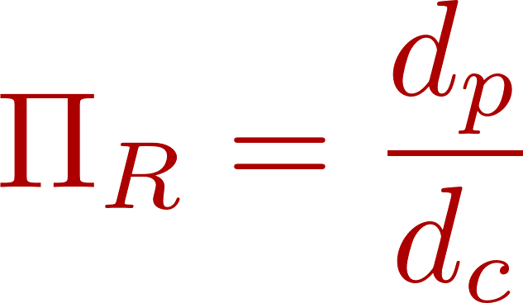
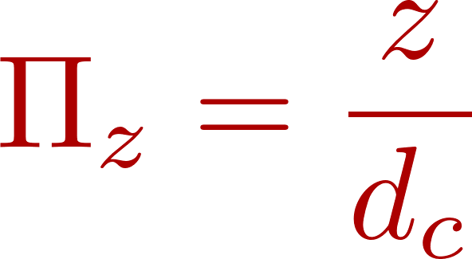
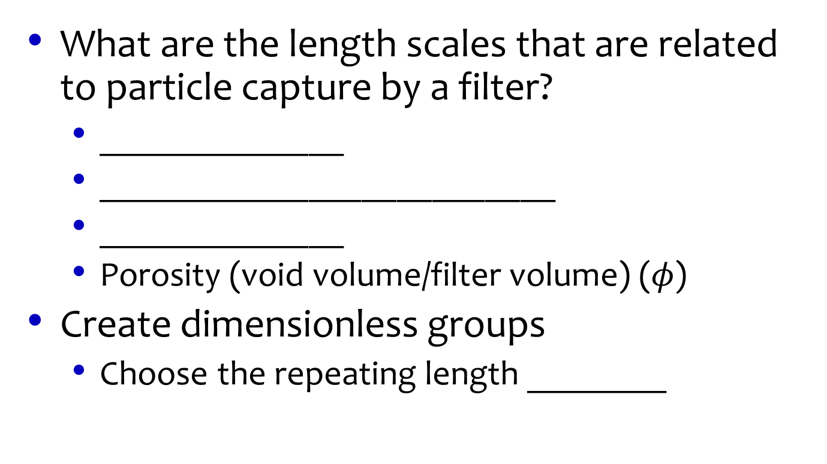
Geometric Parameters
What are the length scales that are related to particle capture by a filter?
______________
__________________________
______________
Porosity (void volume/filter volume) ($φ$)
Create dimensionless groups
Choose the repeating length ________
Filter depth (z)
Collector diameter (media size) (d_{c})
Particle diameter (d_{p})
(d_{c})
Number of collectors!
Definition used in model

Slide 11
Write the functional relationship
Length ratios
Force ratios
α=Attachment efficiency
doubles
If we double depth of filter what does pC* do? ___________
How do we get more detail on this functional relationship?
Empirical measurements
Numerical models

Slide 12
Filtration Model Limitations
Filtration model is really a “clean bed” model
Likely not able to explain performance during a filter run
Doesn’t account for pore filling
pC* is proportional to depth (not consistent with observations of operating filters)
pC* is independent of influent particle concentration (not consistent with observations of operating filters)
Influent particle size distribution is likely very important and may control pC* for real filters

Slide 13
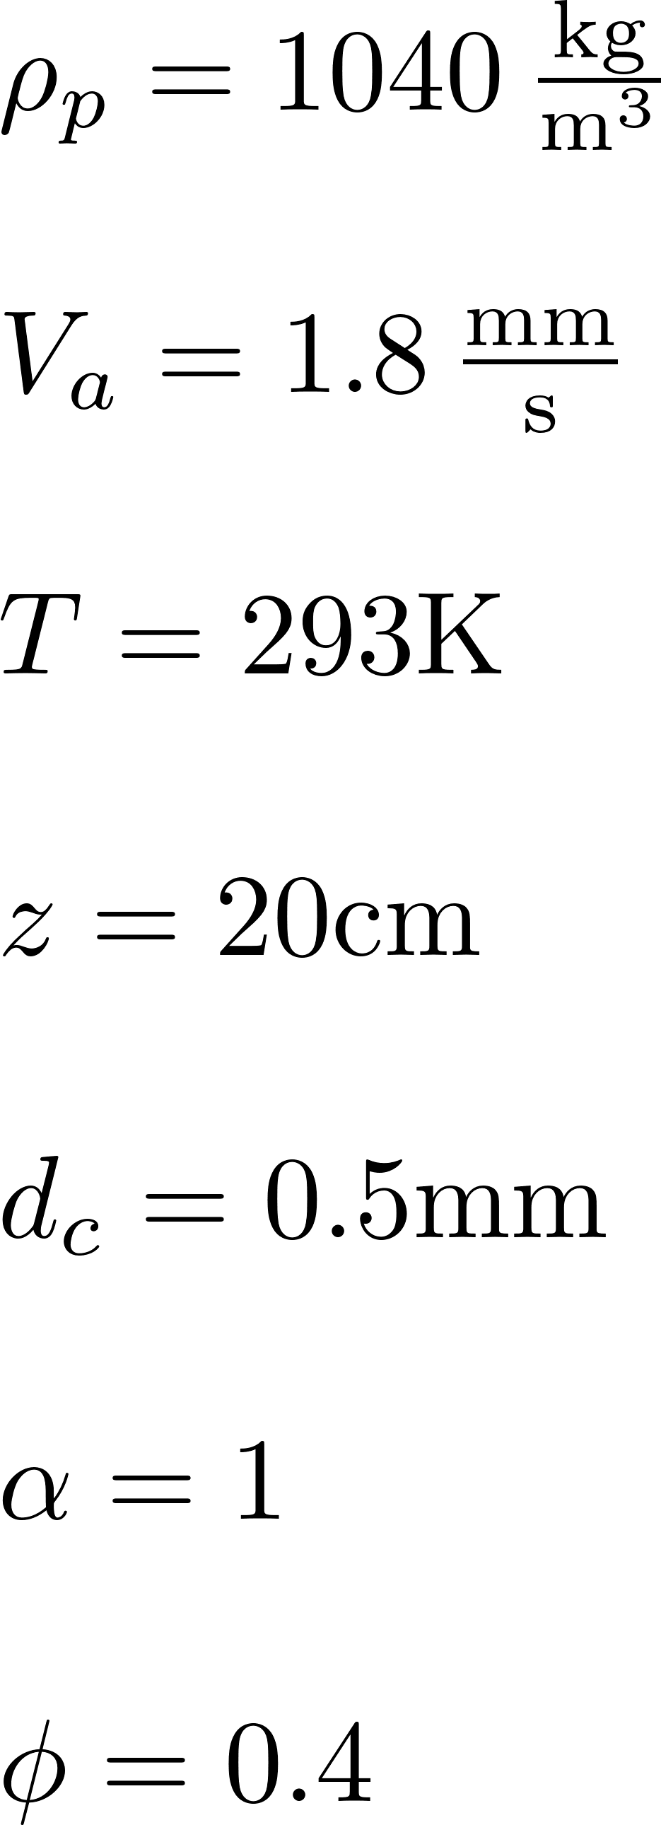
Stacked Rapid Sand Filter predicted performance for biological particle
Not very good at removing particles that haven’t been flocculated
Notes:
Interception is very important
Lousy at removing pathogens if they haven’t been flocculated
A 0.1mm particle has a pC* of 100!!!!!!!!!!
Either particles haven’t be
http://designserver.cee.cornell.edu/aguaclaracode/FiltrationModel.xmcden flocculated or attachment is poor

Slide 14

Stacked Rapid Sand Filter predicted performance for inorganic particle
What is the density of particles that are being removed in a StaRS Filter?
Notes:
Gravity is very important for these dense particles
http://designserver.cee.cornell.edu/aguaclaracode/FiltrationModel.xmcd

Slide 15
StaRS and Fractal Flocs predicted performance
The filtration model combined with the fractal flocculation model suggests that filtration is dominated by interception for all particles sizes for approach velocities above about 1 mm/s.
Notes:
http://designserver.cee.cornell.edu/aguaclaracode/FiltrationModel.xmcd
I see this as a big mystery. If a sticky clay particle can’t attach to a floc in a floc blanket, then is it possible for a clay particle to attach to a sand grain? It would seem that interception (the flocculation mechanism) might not be a viable mechanism for attaching little particles to big particles. So perhaps this is actually about sedimentation!

Slide 16
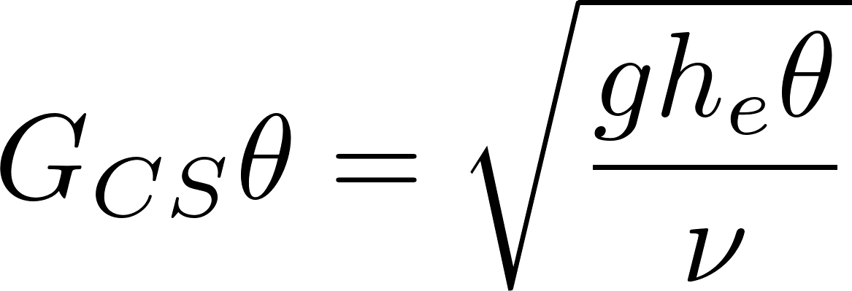
Filter as Flocculator?
Head loss of 40 cm
Residence time of 44 s
Gθ of 13,000!
Filter provides one last chance for flocculation especially after head loss increases

Slide 17
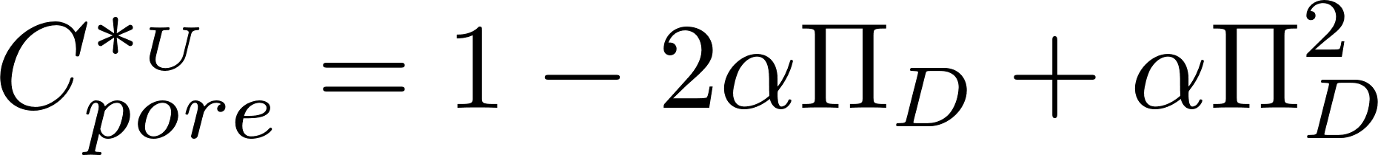
Fraction of particles that make it through a constriction
D_{P}
D_{C}

Slide 18
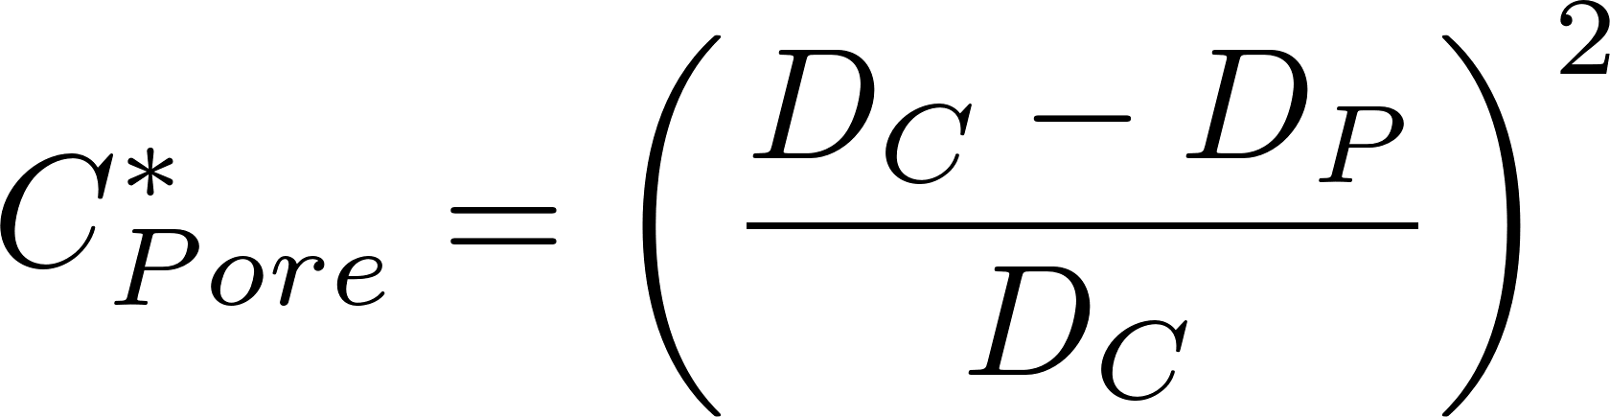
Small particles slip through a small restriction
Constriction diameter
The vast majority of small particles slide right through a constriction

Slide 19
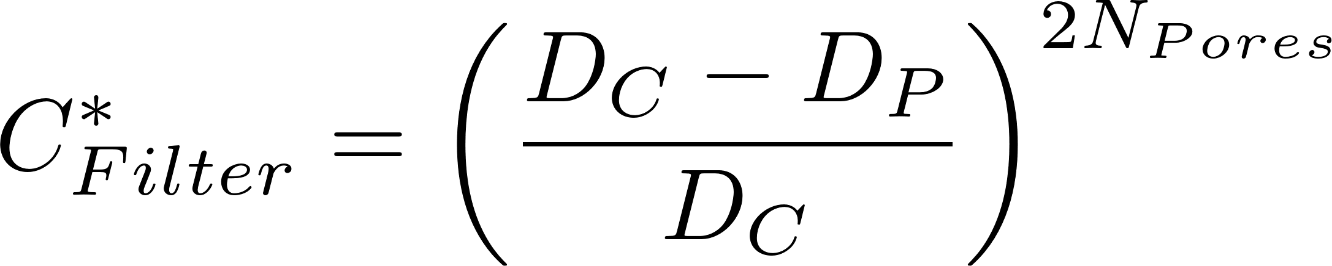
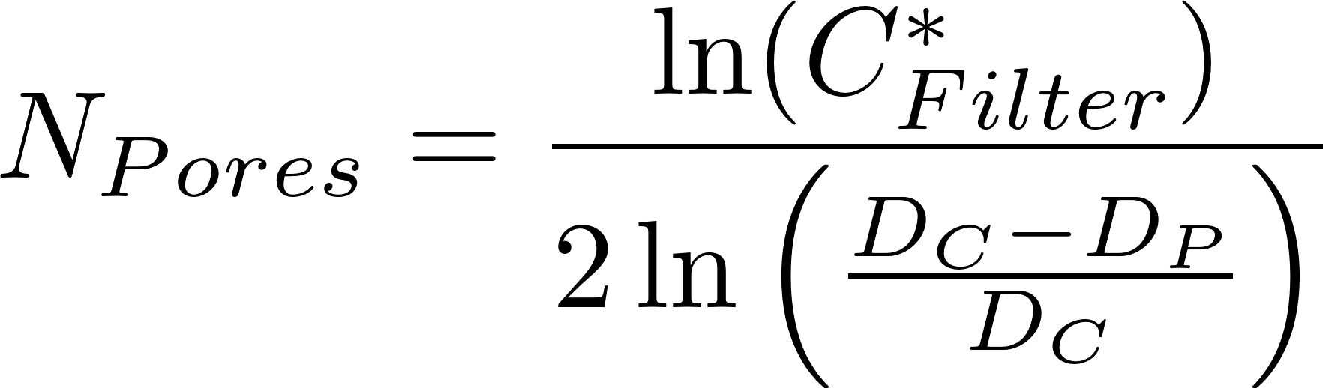
A series of restrictions takes a toll on even the small particles
If we assume complete mixing in each pore, then the probability of slipping through N pores is
Number of pores to get 90% removal
Number of pores to get a target fraction remaining
How much mixing happens in each pore? Is the outer ring of fluid refreshed?

Slide 20
Tiny (or slippery) bad guys sneak through all the security
Some small particles escape flocculation, floc filter, plate settlers, and filter
Because they are small
Or because a few particles aren’t coated with nanoparticles (they are slippery)
Because they never got enough nanoparticles of coagulant
Or the nanoparticles were sheared off during
Failed attachments
Breakup
How could we determine if it is small size or lack of nanoparticles or something else?

Slide 21
References
Tufenkji, N. and M. Elimelech (2004). "Correlation equation for predicting single-collector efficiency in physicochemical filtration in saturated porous media." Environmental-Science-and-Technology 38(2): 529-536.
Cushing, R. S. and D. F. Lawler (1998). "Depth Filtration: Fundamental Investigation through Three-Dimensional Trajectory Analysis." Environmental Science and Technology 32(23): 3793 -3801.
Tobiason, J. E. and C. R. O'Melia (1988). "Physicochemical Aspects of Particle Removal in Depth Filtration." Journal American Water Works Association 80(12): 54-64.
Yao, K.-M., M. T. Habibian, et al. (1971). "Water and Waste Water Filtration: Concepts and Applications." Environmental Science and Technology 5(11): 1105.
M.A. Elliott*, C.E. Stauber, F. Koksal, K.R. Liang, D.K. Huslage, F.A. DiGiano, M.D. Sobsey. (2006) The operation, flow conditions and microbial reductions of an intermittently operated, household-scale slow sand filter
Enhanced Filter Performance by Fluidized-Bed Pretreatment with Al(OH)3(am): Observations and Model Simulation Po-Hsun Lin, Leonard W. Lion, and Monroe L. Weber-Shirk. Journal of Environmental Engineering 1, 389 (2011).

Slide 22
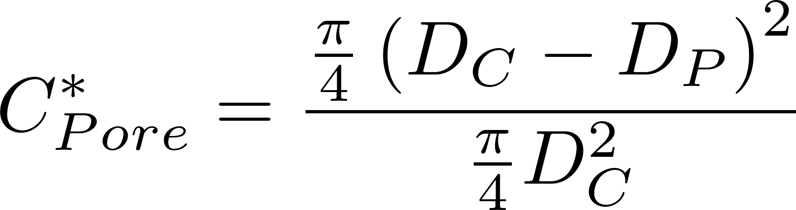
Interception assuming uniform velocity through cross sections
D_{E} Expanded diameter (big pore)
D_{C} Contracted diameter
D_{P} Particle diameter
What fraction of the particles slip through?
D_{P}
D_{C}
D_{P}
D_{C}

Slide 23
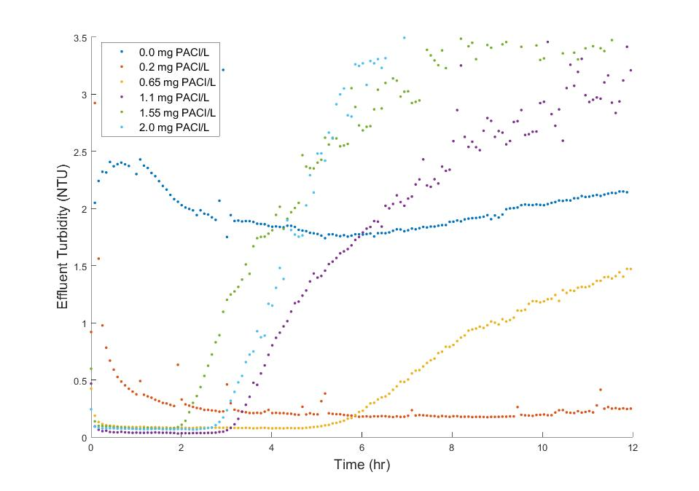
What could cause slippery particles (with too few nanoparticles)?
Pulsing peristaltic pumps
Statistical variability given small number of nanoparticles per clay
Nanoparticles removed during unsuccessful collisions (this could occur during flocculation and/or during filtration

Slide 24
Flocs on their way to the filter
We use weirs and free fall to ensure that the flow is divided equally between filters and is not affected by the head loss of the filter
The elevation drop into the entrance box is approximately 0.4 m.
Velocity is 2.8 m/s
If we assume a 1 cm thick jet of water then the energy dissipation rate is 140 W/kg
The max diameter of a floc is thus 14 μm

Slide 25
Floc removal efficiency increases rapidly with floc size
Perhaps filter performance is largely controlled by the size distribution of influent flocs. We need particle size distribution entering and exiting the filter
Individual clay particles would be hard to capture
20 cm bed of 0.5 mm sand
Notes:
http://designserver.cee.cornell.edu/aguaclaracode/FiltrationModel.xmcd

Slide 26
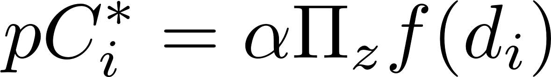
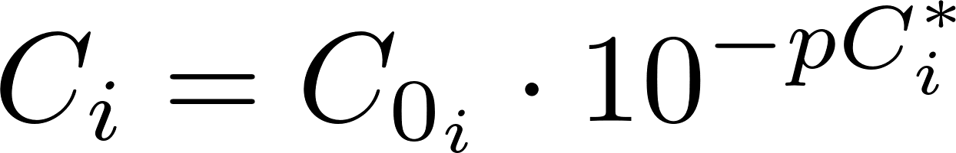
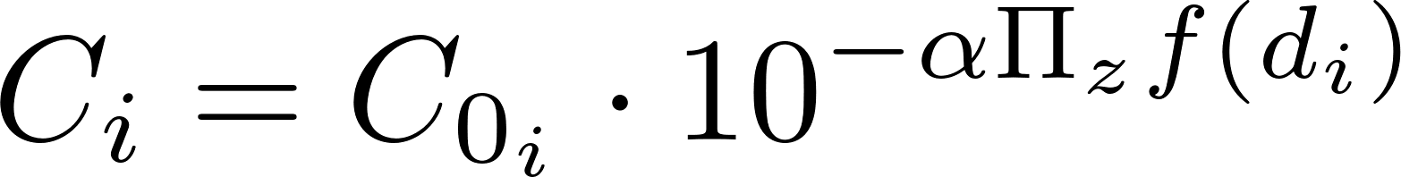
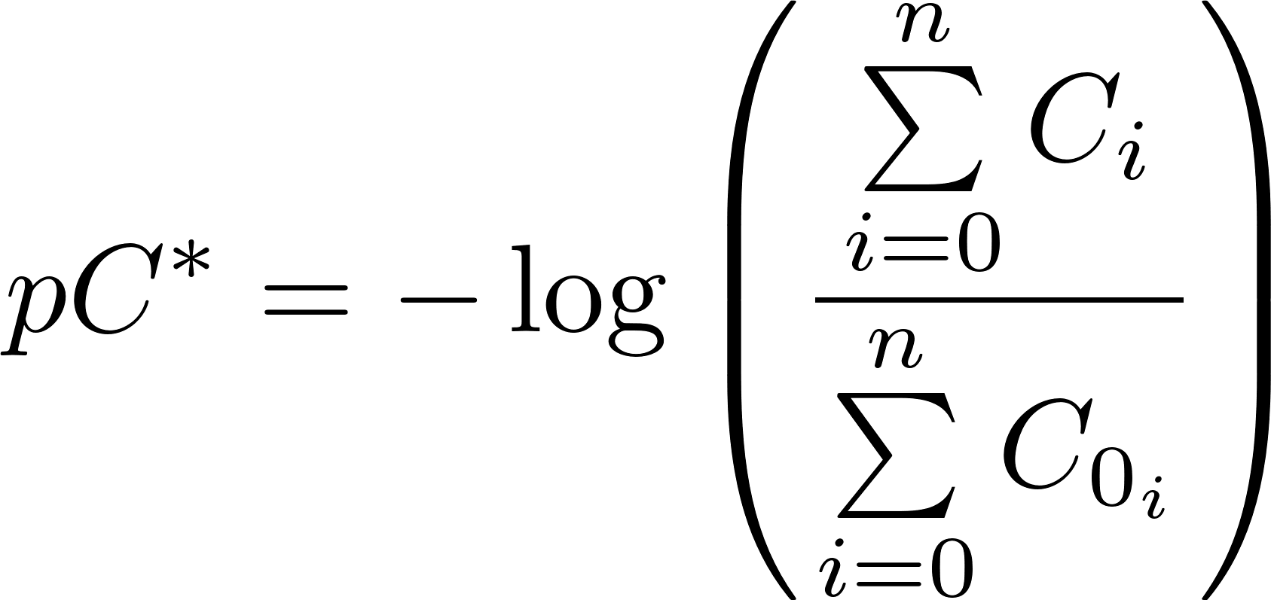
Filtration of mixed particle sizes
Filtration model
Definition of pC* where i represents the bins containing different size fractions
Effluent concentration of each size class
Mixtures produce nonlinear relationship between pC* and filter bed depth

Slide 27
Methods to improve Rapid Sand Filter Performance
Increase attachment efficiency
Flocculate particles to make them larger
Add coagulant to the filter influent to make the filter media and previously captured particles stickier (50 μg/L of Al has been shown to be effective at Cornell Water Treatment Plant)
Po-Hsun Lin 2011
Notes:
Po-Hsun Lin

Slide 28
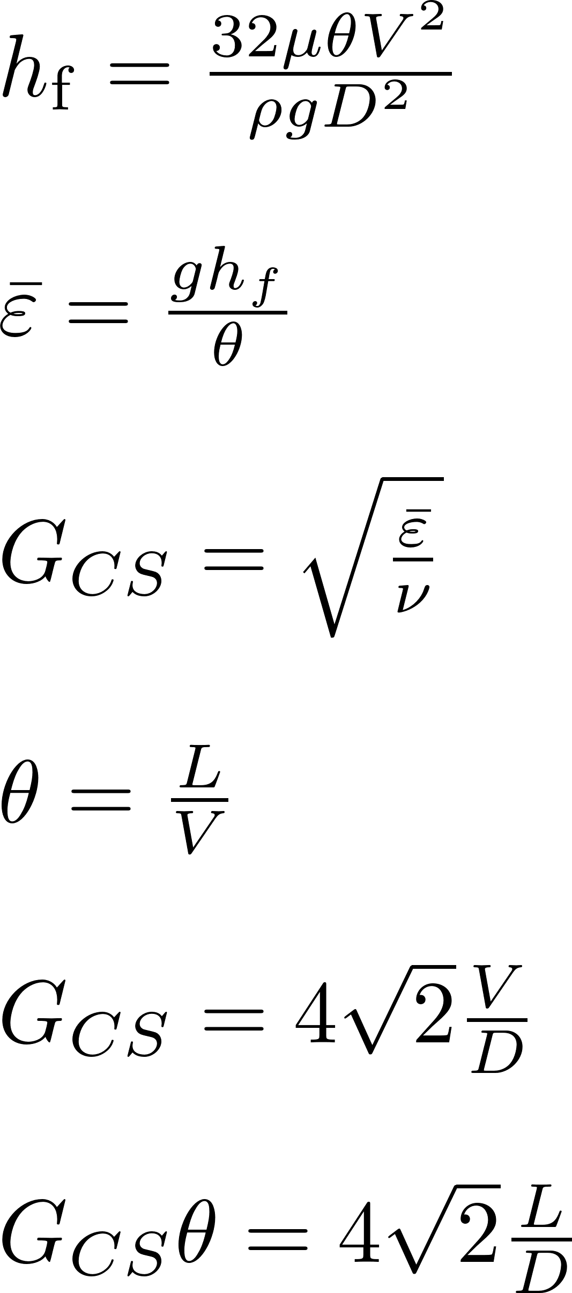
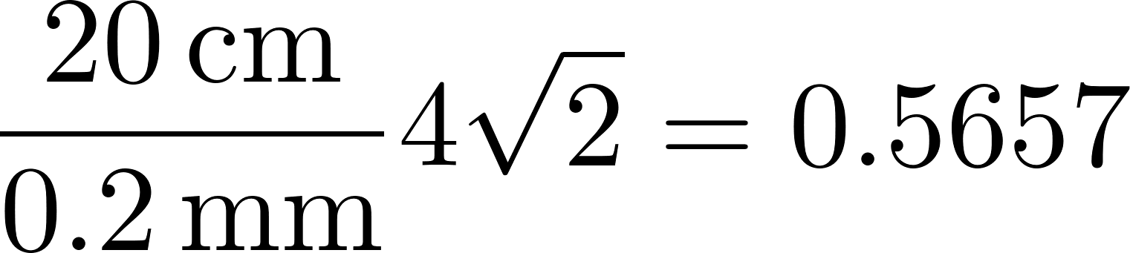
Flocculation may be a significant mechanism inside a filter
The equations are simplified major losses in a clean filter bed
Flocculation increases as head loss increases (another reason for this)
NTU
Time

Slide 29
StaRS Design Guidelines
Settled water is divided evenly between filters that are in filtration mode
Weir into entrance box
need to eliminate air entrainment problem
Backwash filter gets design flow
Each filter has an overflow box
Filtered water flows over a weir into a box taking water to the distribution tank

Slide 30
Graphing Filter Performance
This graph gives the impression that you can reach 100% removal
Where is 99.9% removal?

Slide 31
Developing a Filtration Model
Iwasaki (1937) developed relationships describing the performance of deep bed filters.
C is the particle concentration [number/L³]
λ₀ is the initial filter coefficient [1/L]
z is the media depth [L]
The particle’s chances of being caught are the same at all depths in the filter; pC* is proportional to depth
Notes:
Iwasaki, T. (1937). "Some Notes on Sand Filtration." Journal American Water Works Association 29: 1591.

Slide 32
London van der Waals
The London Group is a measure of the attractive force
It is only effective at extremely short range (less than 1 nm) and thus is NOT responsible for transport to the collector
H is the Hamaker’s constant
Van der Waals force
Viscous force

Slide 33
What about Electrostatic repulsion/attraction?
Modelers have not succeeded in describing filter performance when electrostatic repulsion is significant
Models tend to predict no particle removal if electrostatic repulsion is significant.
Electrostatic repulsion/attraction is only effective at very short distances and thus is involved in attachment, not transport

Slide 34
Numerical Models
Trajectory analysis
A series of modeling attempts with refinements over the past decades
Began with a “single collector” model that modeled London and electrostatic forces as an attachment efficiency term (α)
Interception
Sedimentation
Diffusion
α
Notes:
Yao, K.-M., M. T. Habibian, et al. (1971). "Water and Waste Water Filtration: Concepts and Applications." Environmental Science and Technology 5(11): 1105.

Slide 35
Filtration Model
Porosity
Geometry
Force ratios

Slide 36
Transport Equations
Brownian motion
Interception
Gravity
Total is sum of parts
Transport is additive

Slide 37


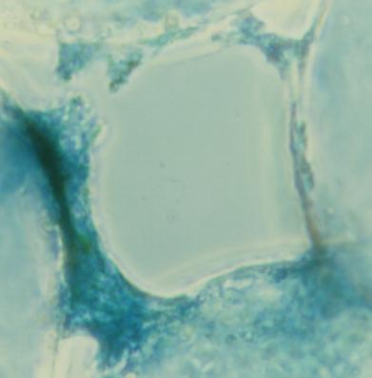
Slow Sand Filtration Mechanisms
Protozoan predators (only effective for bacteria removal, not virus or protozoan removal)
Aluminum (natural sticky coatings)
Attachment to previously removed particles
No evidence of removal by biofilms

Slide 38
Typical Performance of SSF Fed Cayuga Lake Water
1
Fraction of influent E. coli remaining in the effluent
0.1
0.05
0
1
2
3
4
5
Time (days)
(Daily samples)
Filter performance doesn’t improve if the filter only receives distilled water

Slide 39
Particle Removal by Size
1
control
Great for removing giardia (10 µm) and cryptosporidium (4 µm)
3 mM azide
0.1
Fraction of influent particles remaining in the effluent
Effect of the Chrysophyte
0.01
What is the physical-chemical mechanism?
0.001
0.8
1
Particle diameter (µm)
10

Slide 40
E. coli Removal as a Function of Time and Al Application Rate
20 cm deep filter columns
No E. coli detected
Alum
pC* is proportional to accumulated mass of Aluminum in filter
Notes:
This alum dose is below the solubility limit for aluminum. This needs to be verified!

Slide 41
Slow Sand Filtration Predictions
Notes:
If slow sand filters were sticky, they would be incredible. Poor attachment efficiency makes them very inefficient at clay removal.

Slide 42
How deep must a filter (SSF) be to remove 99.9999% of bacteria?
Assume α is 1 and d_{c} is 0.2 mm, V₀ = 0.03 mm/s
pC* is ____
z is ________________
What does this mean?
6
for z of 1 m
23 cm for pC* of 6
Suggests that the 20 cm deep experimental filter was operating at theoretical limit
Typical SSF performance is 95% bacteria removal
Only about 5 cm of the filters are doing anything!

Slide 43

Head Loss Produced by Aluminum in SSF

Slide 44
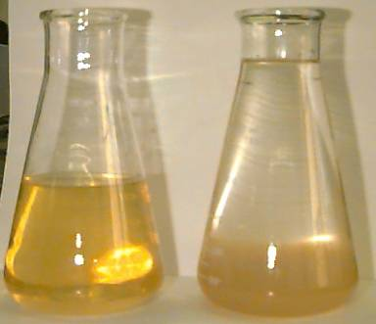
Cayuga Lake Seston Extract
Concentrate particles from Cayuga Lake
Acidify with 1 N HCl
Centrifuge
Centrate contains polymer
Neutralize to form flocs

Slide 45
Seston Extract Analysis
I discovered aluminum!
carbon
16%
How much Aluminum should be added to a filter?

Slide 46
Aluminum feed methods
Alum must be dissolved until it is blended with the main filter feed above the filter column
Alum flocs are ineffective at enhancing filter performance
The diffusion dilemma (alum microflocs will diffuse efficiently and be removed at the top of the filter)

Slide 47
Performance Deterioration after Al feed stops?
Hypotheses
Al washes out of filter
Decays with time
Sites are used up
Research results
Not yet clear which mechanism is responsible – further testing required

Slide 48
Sticky Media vs. Sticky Particles
Sticky Media
Potentially treat filter media at the beginning of each filter run
No need to add coagulants to water for low turbidity waters
Filter will capture particles much more efficiently
Sticky Particles
Easier to add coagulant to water than to coat the filter media

Slide 49
“BioSand” (Intermittent SSF – ISSF) Performance
Pore volume is 18 Liters
Volume of a bucket is ____________
Highly variable field performance even after initial ripening period
20 Liters
Field tests on 8 NTU water in the DR
http://www.iwaponline.com/wst/05403/0001/054030001.pdf
pC*
Notes:
http://www.iwaponline.com/wst/05403/0001/054030001.pdf

Slide 50
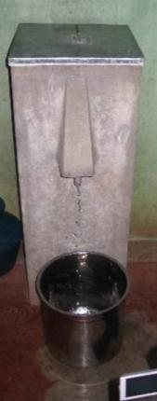
The “BioSand” Filter Craze
Intermittent Slow Sand Filters (ISSF)
Patented “new idea” of intermittent slow sand filtration without flow control and called it “BioSand”
Filters are being installed around the world as Point of Use treatment devices
Cost is somewhere between $25 and $150 per household ($13/person based on project near Copan Ruins, Honduras)
The per person cost is comparable to the cost to build centralized treatment using the AguaClara model

Slide 51
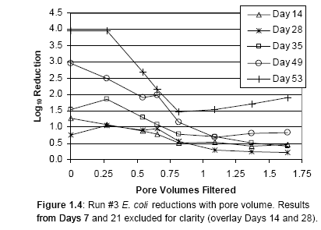
Intermittent Slow Sand Filter Performance
Notes:
The operation, flow conditions and microbial reductions of an intermittently operated, household-scale slow sand filter
M.A. Elliott*, C.E. Stauber, F. Koksal, K.R. Liang, D.K. Huslage, F.A. DiGiano, M.D. Sobsey.
*University of North Carolina, CB 7431, Chapel Hill, NC, 27514, USA.
Long ripening period
After pore volume is flushed has poor performance

Slide 52
Field Performance ISSF
Table 2 pH, turbidity and E. coli levels in raw and ISSF effluent in the field
Parameter raw filtered
Mean pH (n =47) 7.4 8.0
Mean turbidity (NTU) (n=47) 8.1 1.3
Mean log₁₀ E. coli MPN/100mL (n=55) 1.7 0.6
Turbidity pC*(0.8) and E. coli pC* (0.35) is poor and confirms that filters are NOT appropriate as a single treatment step for highly contaminated waters.
http://www.iwaponline.com/wst/05403/0001/054030001.pdf

Slide 53
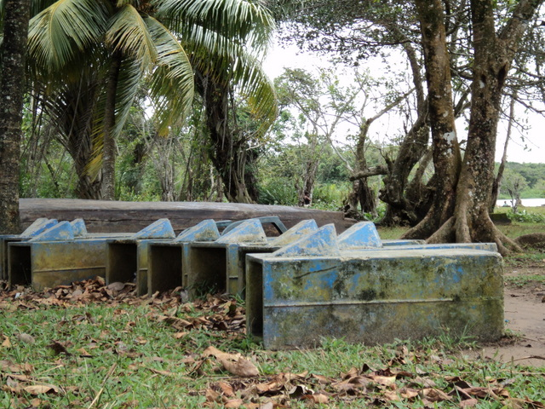
Notes:
Photo courtesy of Sarah Long taken In La Mosquitia, Honduras in October of 2010.

Slide 54


Potters for Peace Pots
Colloidal silver-enhanced ceramic water purifier (CWP)
After firing the filter is coated with colloidal silver.
This combination of fine pore size, and the bactericidal properties of colloidal silver produce an effective filter
Filter units are sold for about $10-15 with the basic plastic receptacle
Replacement filter elements cost about $4.00
What is the turbidity range that these filters can handle?
How do you wash the filter? What water do you use?

Slide 55








Filter range of applicability The “if it is dirty, filter it” Myth
SSF
RSF+
DE
Cartridge
Bag
Pot
Candle
1
10
*?
NTU
?
?
100
?
?
* Multi-Stage Filtration
1000
Notes:
http://www.lenntech.com/cartridgefilter-bagfilter.htm
http://www.nesc.wvu.edu/ndwc/pdf/OT/TB/OT_TB_su01.pdf on DE filters

Slide 56


Filters Galore
Slow Sand
Bag
Rapid Sand
Pot
Stacked Rapid Sand
Intermittent Slow Sand
Rough
Candle

Slide 57
Filtration with pores partially filled with Aluminum Hydroxide
25% of void is filled with floc
Conventional performance
Notes:
Enhanced Particle Capture through Aluminum Hydroxide Addition to Pores in Sand Media
Authors: Po-Hsun Lin, Leonard W. Lion, and Monroe L. Weber-Shirk*

Slide 58
Filtration with pores partially filled with Aluminum Hydroxide
Alum fluidized-bed pretreatment. Particle removal (pC*) over time by a sand filter as a function of the pretreatment dose (mol Al/m³). Raw water pH was 7. The results were smoothed by averaging the raw data over 30 second intervals. No coagulant in feed!!!!
Notes:
Enhanced Particle Capture through Aluminum Hydroxide Addition to Pores in Sand Media
Authors: Po-Hsun Lin, Leonard W. Lion, and Monroe L. Weber-Shirk*

Slide 59
Need to devise fluidized bed equations
Base model on terminal velocity equations that transition into the turbulent regime
Equations will be

Slide 60
Fluidized bed equations
Calculate separation distance between sand grains
Use flat plate equations to get velocity gradients
We need average vertical shear on sand grain to get vertical force.
Set shear force equal to net gravity force
Calibrate equation by setting equal to Kozeny at fluidization initiation

Slide 61
Average Separation
Calculate vertical projection of sand grain surface area (or simple surface area)
Average horizontal distance between sand grains (center to center and then gap).
Use separation distance to calculate velocity gradient
* This method gets quite complex because boundary layer is developing over scale of a sand grain

Slide 62
Innovation Questions Key questions to ask
Why is this hard? (led to the StaRS)
What is the limitation of the existing design?
How could we change this geometry?
Turn it inside out
Rotate it
Shrink it
Expand it
Why are these our only options?
Could we cross pollinate our options?

Slide 63

Alternative to deep filter boxes - Pressure RSF
Proper backwashing of a pressure filter is difficult because the filter sand is not visible to the operator.
Observation of the following are not possible
Presence of filter cracks or mudballs
Backwash water distribution
Uniformity of rate of cleanup of the wash water over the full filter area
Proper functioning of the auxiliary scour devices
Elevation and appearance of the top surface of the sand after the backwash
Extent of fluidization and bed expansion during backwash
Loss of filter media
Some state regulatory agencies prohibit use of pressure filters for drinking water treatment
Notes:
Page 8.73 in Water Quality and Treatment: A Handbook of Community Water Supplies. Fifth edition.
Photo is of abandoned filters at El Cambray water treatment plant in Guatemala City

Slide 64



Backwash Velocity
Π_{FiBw} is expanded bed depth over settled bed depth
(Effective size)
0.45 mm E.S. with 1.65 U.C. = D₆₀ 0.72 mm
Fluidize at 5 mm/s
30% bed expansion at 12 mm/s
Notes:
This seems a bit of a stretch because we are starting with pipe flow equations. It might be better to switch to sphere sedimentation equations.
Karmen Kozeny valid up to Re of 6
Page 8.10 in Water Quality and Treatment: A Handbook of Community Water Supplies. Fifth edition.

Slide 65


Siphon Geometry for Air trap
What must be true for the air in the siphon air trap?
Mass of air must be conserved
Volume of air is NOT conserved
Pressure in the air is independent of elevation
Depth of “submergence” (hydrostatic pressure) must be the same at both ends of the siphon!
What relationship can we use to final volume of air given initial volume of air?
PV=nRT

Slide 66

Siphon Geometry
L2
H3
What determines how much air we trap?
What happens as head loss increases?
H1
L1₀
L3₀
H1
H3
H2
H2
Success requires two things
1. Start backwash whenever desired (optional).
2. Prevent backwash from starting before reaching max head loss.
H1
H1
Notes:
As head loss increases H1 increases. That means that some water must flow out of the end of the siphon pipe. That means that the water level in the vertical section of pipe inside the filter box must rise too! At some point we will get H1=H3 and the siphon will start flowing!

Slide 67








Siphon Geometry for Air trap
0
1

Slide 68



Maximum water level that can be held by siphon
Failure mode is when H₁=H₃ Set H₁=H₃, then solve for H₃
This is the maximum value of H₃

Slide 70

Maximum water level that can be held by siphon
The max water level is set by the overflow weir in the inlet box
We should include a safety factor of perhaps 10 cm to ensure that the siphon doesn’t start leaking before the filter reaches max head loss
The disadvantage of a higher invert is that the water level in the filter box must be higher in order to initiate backwash.
Notes:
Our previous design constraint was that the top of the U had to be below the minimum water level in the filter box so that backwash could be initiated even with a clean filter bed. We are going to eliminate that constraint and say that there is a need to backwash immediately after starting to filter that it will be necessary to block the filter outlets to raise the water level. This would be an unusual circumstance.

Slide 71


Expanded Bed Porosity
Filter expansion ratio
Backwash porosity
Pore volume + volume above bed = Expanded bed pore volume
Total expanded volume
Now we can relate porosity and filter expansion ratio
Notes:
Sand fraction * height of sand is conserved!

